Slide 1
Viruses and Prokaryotes
Biology II

Slide 2
Viruses
Replicate only by infecting living cells
Differ widely in size and structure
One thing in common: enter living cells and use the machinery of the infected cell to produce more viruses

Slide 3
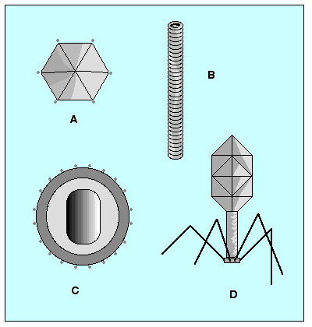
What is a Virus?
A particle (not a cell!) made up of:
Nucleic acid
DNA or RNA
Protein
DNA or RNA is surrounded by a protein coat, or capsid
Sometimes lipids

Slide 4
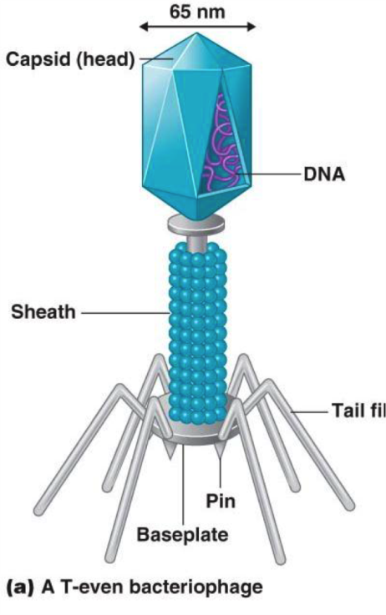
Capsid
Capsid proteins bind to the surface of a cell
Proteins “trick” the cell into allowing it inside
Viral genes take over the cell
Cell transcribes the viral genes, putting the genetic program of the virus into effect
Often times the virus destroys the cell

Slide 5
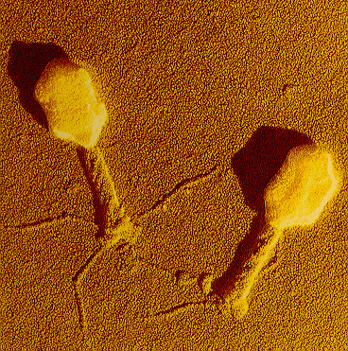
Viral Infection: Lytic or Lysogenic
Viruses must bind precisely to proteins on the cell surface and then use the host’s genetic system
Most viruses are highly specific to the cells they infect
Bacteriophage: a virus that infects bacteria

Slide 6
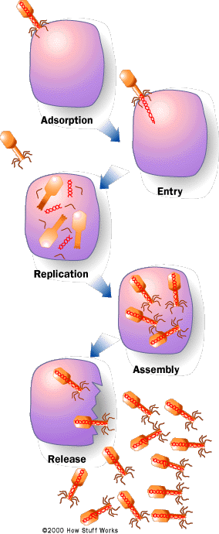
Lytic Infection (HOSTAGE SITUATION)
A virus enters a cell, makes a copy of itself, and causes the cell to burst
Virus injects its DNA into the host
Usually the host cannot tell that the DNA is foreign and ends up copying the viral DNA!
The infected cell lyses, or bursts, and releases hundreds of virus particles that may go on to infect other cells

Slide 7
Human Lytic Viruses
Smallpox (Variola) - Repiratory and then systemic. (Last known "natural" case in Somalia 1977. There was a laboratory acquired case later).
Respiratory Syncytial Virus (RSV) - Severe lung infections in infants. Infects respiratory tract but spread by contact. Handwashing is important.
Adenovirus - Mild to severe infections of the respiratory tract, Eye infections and gastrointestinal infections.
Rhinovirus - "Common cold virus" infects the upper respiratory tract.
Norwalk Virus - Gastroenteritis in older children and adults. Fecal-oral transmission.
Rotavirus - Gastroenteritis in infants and young children. Fecal-oral transmission.
Measles (rubeola) - Repiratory infection first and then systemic
Rubella (german measles) - Respiratory first and then systemic. Congenital infections are a serious concern.
Influenza Virus - Severe respiratory infections. Three serotypes: A, B and C. Serotype A also infects birds and other mammals where it trades genetic information with bird and mammal strains of influenza virus. Giving aspirin to children with influenza and chickenpox may lead to Reye's syndrome.
Polio Virus - Infects the GI tract first then through the blood to the central nervous system. Spread by oral-fecal route.
Rabies Virus - Spread by the saliva in the bite of an infected animal. Infects muscle cells at bite site then moves to the central nervous system and the salivary glands.
Hemorrhagic fevers- A number of viruses cause damage to the small blood vessels causing hemorrhage throughout the body: Ebola - spread by blood and body fluids, reservoir unknown;Lassa Fever - spread by rodent urine and feces and also by blood and body fluids of infected individuals; Dengue Fever (breakbone fever)- spread by mosquitoes that have bitten infected people; Yellow Fever - spread by mosquitoes that have bitten infected people or infected monkeys.
Hepatitis A and E - Transmitted through fecal-oral route. Infects the intestine and then through the blood to the liver.

Slide 8
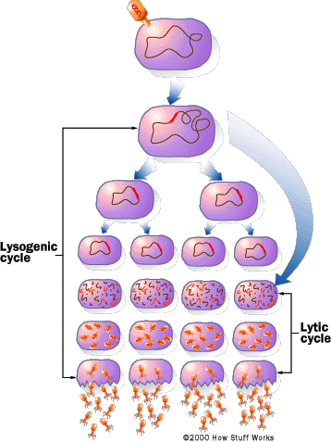
Lysogenic Infection (BRAINWASHED CELL)
A virus embeds its DNA into the DNA of the host cell and is replicated along with the host cell’s DNA
Prophage: the DNA that is embedded in the host’s DNA
Infection that causes the host cell to make copies of the virus indefinitely
Do not lyse the host cell right away
Eventually the viral DNA will remove itself from the host DNA and direct the synthesis of new virus particles
Laundry example… these must be my socks…I’ll wash them

Slide 9
Human Lysogenic Viruses
Herpes Viruses:
Herpes simplex - infects epithelium of mouth or genitals then travels up nerve axons to become latent in ganglia of the spinal column. Neonatal infections are very severe. Spread by secretions from active lesions.
Varicella-Zoster Virus - Causes both chickenpox and shingles (herpes zoster). Shingles is the manifestation of a latent infection. Spread by the respiratory route.
Epstein-Barr Virus (EB virus) - Causes mononucleosis which is spread by contact with infected saliva. Initially infects the oral or genital mucosa but then spreads to B-lymphocytes. This virus is associated with two malignancies: Burkitt's lymphoma and nasopharyngeal carcinoma.
Cytomegalovirus (CMV) - Infection from contact with infected saliva and other secretions. The virus infects mucous epithelium and white blood cells. Many children and adults harbor latent infections which are totally assymptomatic. Immunocompromised people may suffer devastating lung, central nervous system and other systemic infections.
Papilloma Virus - These viruses cause a variety of warts and they are spread by close contact. Three types (16, 18 and 31) have been associated with cervical and penile cancers.
Hepatitis B (HBV) - Spread through saliva and all other secretions and also vertically (from mother to child during birth or rarely in utero). Severe infection of the liver. Some people may develop chronic hepatitis and become life long carriers of the virus. This virus is strongly associated with liver cancer (hepatocellular carcinoma).
Retrovirus - Both Human Immunodeficiency Virus (HIV) and Human T-cell Lymphotropic Virus-1 (HTLV-1) belong to this group. These viruses infect T-cells and are spread by blood and body fluids. HTLV-1 is notable for two reasons: (1) it is transmitted to infants through mother's milk and (2) it causes adult onset T-cell leukemia.

Slide 10
Viruses and Disease
Polio, measles, AIDS, mumps, influenza, rabies, common cold
In most viral infections, viruses attack and destroy certain cells in the body, causing the symptoms of the disease
Vaccines
A weakened or killed virus or viral proteins that stimulates the immune system to produce immunity to the disease
Used to prevent infection
Provide protection only if used before an infection begins

Slide 11
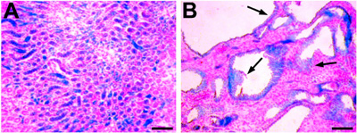
Viruses and Cancer
Oncogenic viruses cause cancer in animals
Carry genes that disrupt the normal controls over cell growth and division
By studying such viruses, scientists have identified many of the genes that regulate cell growth in eukaryotes

Slide 12
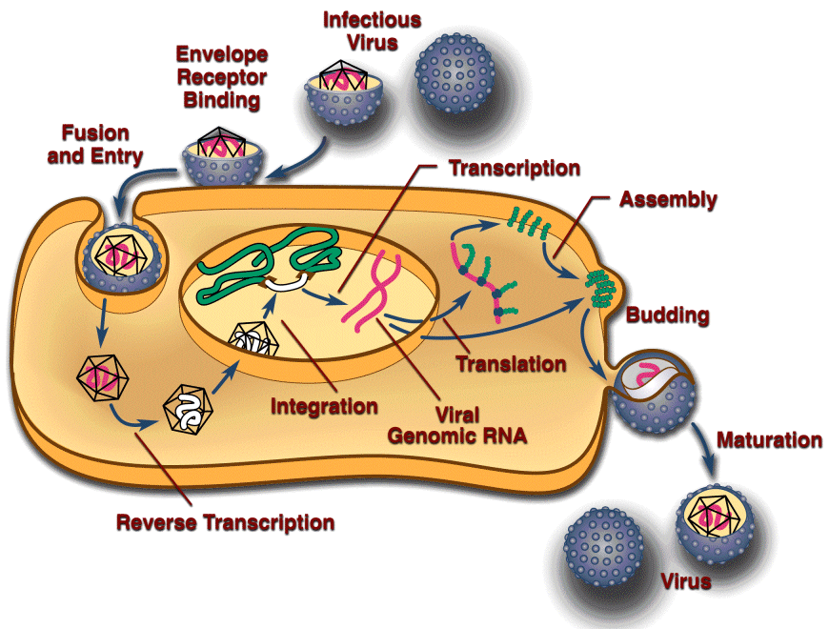
Retroviruses
Viruses that contain RNA as their genetic information
“Retrovirus”
Genetic information is copied backward
From RNA to DNA
Mistakes can be made
This DNA is inserted in the host DNA
Responsible for some types of cancer in animals
HIV, the seasonal flu

Slide 13
Prions
Infectious particle made up of a misfolded protein rather than RNA or DNA
Prions accumulate, especially in the nervous system, that cells become damaged or destroyed
Prions are resistant to heat and digestive enzymes, so they are not destroyed by cooking infected meat
An extremely simplified and highly unrealistic depiction of the normal prion protein (A) and the misfolded prion protein (B).

Slide 14
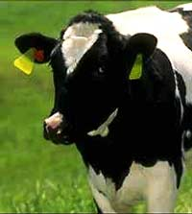
Mad Cow Disease
In 1985, veterinarians in Great Britain found cows suffering from a disease that, like scrapie in sheep, attacked and destroyed parts of the brain
BSE (for "bovine spongiform encephalopathy"), but the erratic behavior of infected cattle led to the common name of "mad cow disease"
When evidence emerged that mad cow disease and Creutzfeldt-Jakob disease (CJD), a similar disease in humans, might be caused by prions, people began to worry.
Was it possible that more than 100 people in Britain had died from CJD caused by prion-infected beef?

Slide 15
Mad Cow Disease
In 1996, British authorities concluded that the practice of using tissue from sheep and cows to prepare cattle feed had made it possible for BSE to spread rapidly to cattle and then to humans who ate contaminated beef.
They banned the use of cattle tissue in feed, and a similar ban was put in force in the United States the very next year.
In 2002, however, BSE was discovered in cows in Canada, and near the end of 2003, tissue from a Washington state cow with BSE was discovered after its meat had been processed.

Slide 16
H1N1
What is H1N1?
Why was it called “swine flu”?
A new influenza virus that was causing illness in people
First detected in people in the United States in April 2009
June 11, 2009, the World Health Organization (WHO) signaled that a pandemic of 2009 H1N1 flu was underway
Laboratory testing showed that many of the genes in this new virus were very similar to influenza viruses that normally occur in pigs (swine) in North America
Further study has shown that it is very different from what normally circulates in North American pigs
It has two genes from flu viruses that normally circulate in pigs in Europe and Asia and bird (avian) genes and human genes
2 surface proteins: hemagglutinin (H) & neuraminidase (N)

Slide 17
H1N1
How did H1N1 virus spread?
What were the signs & symptoms?
The same way that seasonal flu spreads
Person to person
coughing or sneezing
touching something (such as a surface or object) with flu viruses on it and then touching the mouth or nose
Fever
Cough
Sore throat
Runny or stuffy nose
Body aches
Headache
Chills
Fatigue
Diarrhea
Vomiting
Severe illnesses and death

Slide 18
H1N1
How long can an infected person spread this virus to others?
What can I do to protect myself from getting sick?
1 day before getting sick to 5 to 7 days after.
This can be longer in some people, especially children and people with weakened immune systems
Vaccination BEFORE sickness
Cover your nose and mouth with a tissue when you cough or sneeze. Throw the tissue in the trash after you use it.
Wash your hands often with soap and water, especially after you cough or sneeze.
Avoid touching your eyes, nose or mouth.
Try to avoid close contact with sick people.
If you are sick with flu-like illness, stay home for at least 24 hours after your fever is gone except to get medical care or for other necessities.

Slide 19
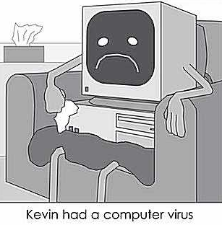
Are Viruses Alive?
FOR: Viruses share the genetic code with living things and affect living things
AGAINST: They do not have all the characteristics of life (chapter 1)
VERDICT: NO!!!

Slide 20
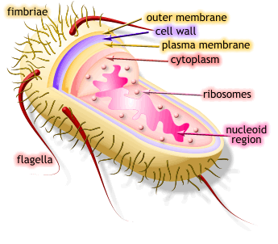
Prokaryotes
Single-celled organisms that lack a nucleus
Circular DNA
Range in size from 1-5 micrometers
(Eukaryotic cells range in size from 10-100 micrometers)

Slide 21
Classifying Prokaryotes
Domain Bacteria
Kingdom Eubacteria
Domain Archaea
Kingdom Archaebacteria
Domain Eukarya
Kingdom Protista
Kingdom Plantae
Kingdom Fungi
Kingdom Animalia
Current Classification
(Former Kingdom Monera)

Slide 22
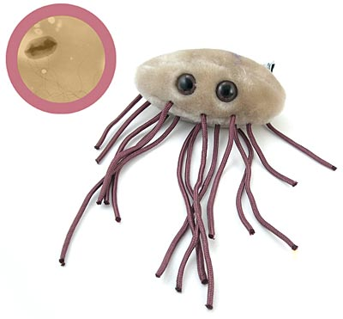
Domain Bacteria: Kingdom Eubacteria
What we think about when we say “bacteria”
Cell well contains peptidoglycan (murein)
Made of sugars and amino acids
Larger of the two prokaryotic domains
Live almost anywhere

Slide 23
Domain Bacteria: Examples
Cyanobacteria: photosynthetic, like plants, which means that they use the sun’s energy to make food for themselves.
Spirochetes: are gram-negative spiral-shaped, and heterotrophic. Some of them live in the presence of oxygen, others don’t.
Gram-positive bacteria: includes the strain of streptococcus bacteria that causes strep throat. It also includes the bacteria that produces yogurt, by growing and fermenting in milk (producing lactic acid). These bacteria also produce many of our antibiotics.
Proteobacteria: is one of the largest phyla of all the bacteria. Many are gram-negative. They are divided into several subgroups, such as enteric bacteria, chemoautotrophs, and nitrogen-fixing bacteria. The enteric bacteria live mainly in intestinal tracts, like E. coli.

Slide 24
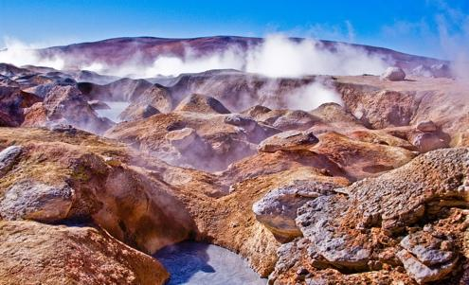
Domain Archaea: Kingdom Archaebacteria
Under a microscope look similar to eubacteria
Lack peptidoglycan (murein) in cell walls
Membrane lipids are quite different
Found in very harsh conditions
bottom of the sea
volcanic vents
Early Earth’s atmosphere was filled with poisonous gases and was very hot – nothing could survive, except the archaebacteria.
Obligate anaerobes
They cannot live in the presence of oxygen

Slide 25
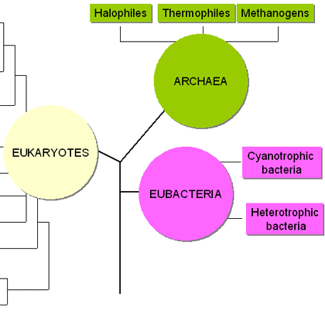
Domain Archaea: Examples
Methanogens: are characterized by their ability to harvest energy by converting H2 and CO2 into methane gas; found in marshes and in the intestinal tracts of humans and some animals
Halophiles: salt-loving; found in the Dead Sea, the Great Salt Lake, and other areas with a high salt content
Thermoacidophiles: found in extremely acidic conditions and in areas with very high temperatures. They can survive in areas with temperatures as high as 230ₒF and with pHs below 2; locations include volcanic vents and hydrothermal vents (cracks in the ocean floor where scalding water leaks out)

Slide 26
Archaea to Eukarya
DNA of archaebacteria genes are more like those of eukaryotes than those of eubacteria
Scientists believe they may be the ancestors of eukaryotes

Slide 27
Identifying Prokaryotes
Shape
Cell wall chemical structure
Movement
Energy obtainment

Slide 28
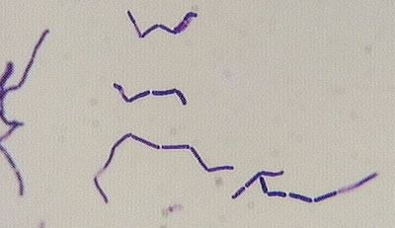
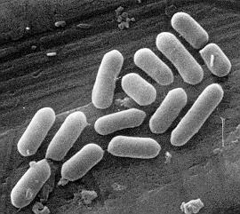
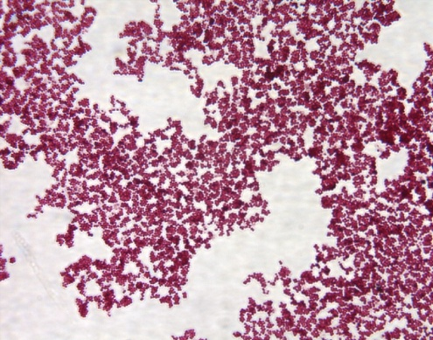
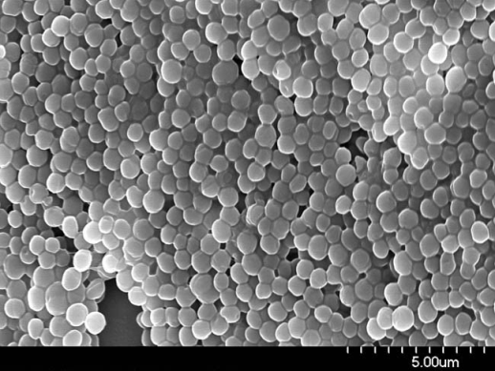
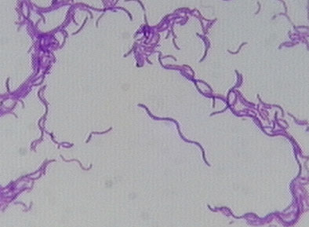
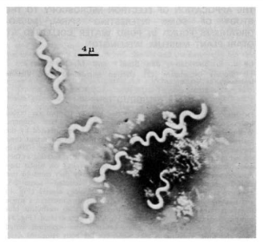
Prokaryote Shape
Bacilli
Rod-shaped
Cocci
Spherical-shaped
Spirilla
Spiral and corkscrew-shaped

Slide 29
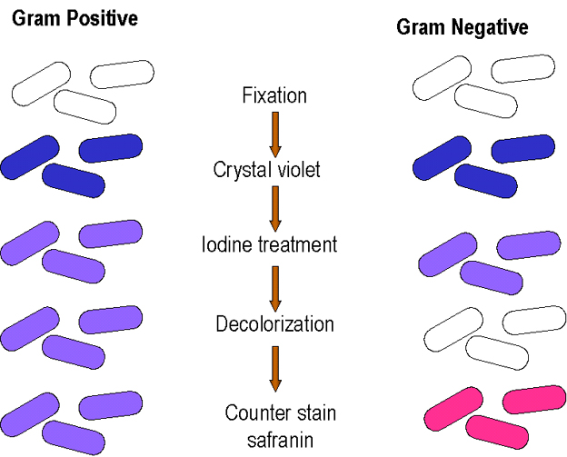
Cell Wall Chemical Structure: Gram Staining in Eubacteria
Determines:
Resistance to antibiotics
Identify an unknown bacteria
Staining a group of bacteria with four different liquids

Slide 30
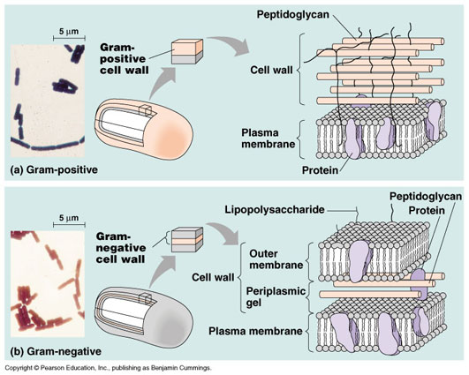
Gram Positive: Purple
Cell wall containing many peptidoglycan, which absorbs the gram stain
More susceptible to antibiotics than gram-negative bacteria
Why?
They are not selectively permeable
They let everything into the cell…including antibiotics
Good for us, bad for them!

Slide 31
Gram Negative: Red
Cell wall containing a second, outer layer of lipids & carbohydrates
Selectively permeable and gram stain cannot pass through
Antibiotics cannot pass through either
Good for them, bad for us!

Slide 32
Prokaryote Movement
Flagella
Lash
Snake
Spiral
Move on a slime trail
No movement at all

Slide 33
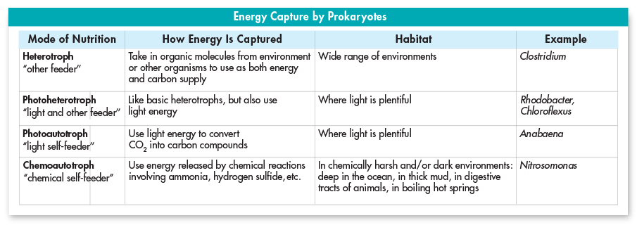
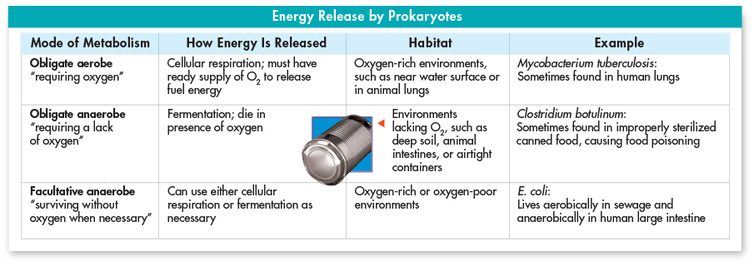

Slide 34
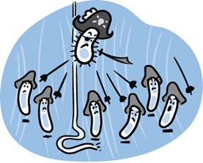
Growth and Reproduction
When conditions are favorable, prokaryotes can grow and divide at astonishing rates
As often as every 20 minutes!

Slide 35
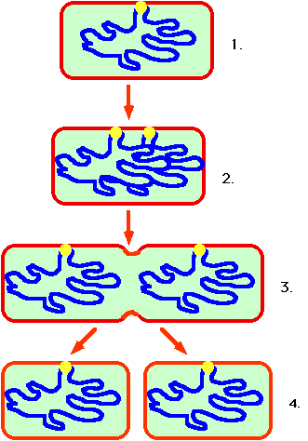
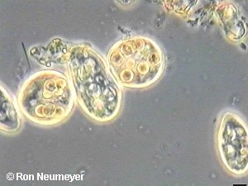
Reproduction: Binary Fission
Asexual reproduction
Prokaryote replicates its DNA
Divides in half, produces two identical daughter cells

Slide 36
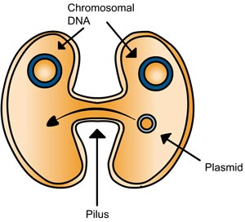
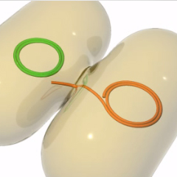
Reproduction: Conjugation
Sexual reproduction
Paramecia and some prokaryotes
Exchange genetic information through a hollow bridge
(Think “conjunction-junction” song)

Slide 37
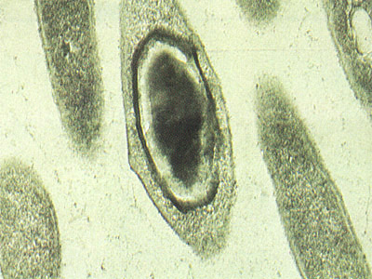
Reproduction: Endospore
Formed when conditions become unfavorable for reproduction
Bacterium produces a thick internal wall
Wall encloses its DNA and a portion of its cytoplasm to remain dormant until good conditions arise

Slide 38
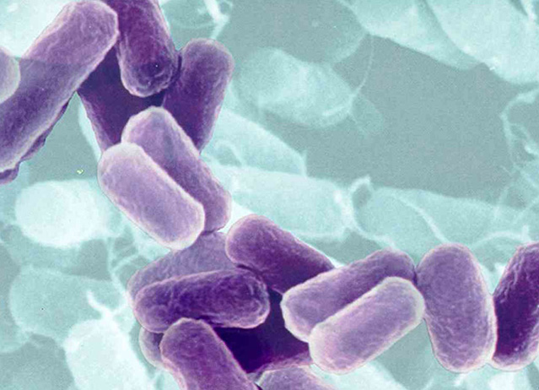
Bacteria in Nature
Bacteria are vital to maintaining the living world
Some producers that capture energy by photosynthesis
Other help to break down the nutrients in dead matter and the atmosphere, allowing other organisms to use the nutrients

Slide 39
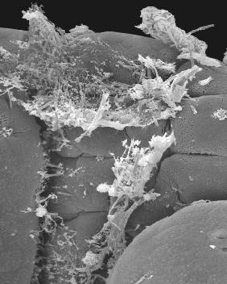
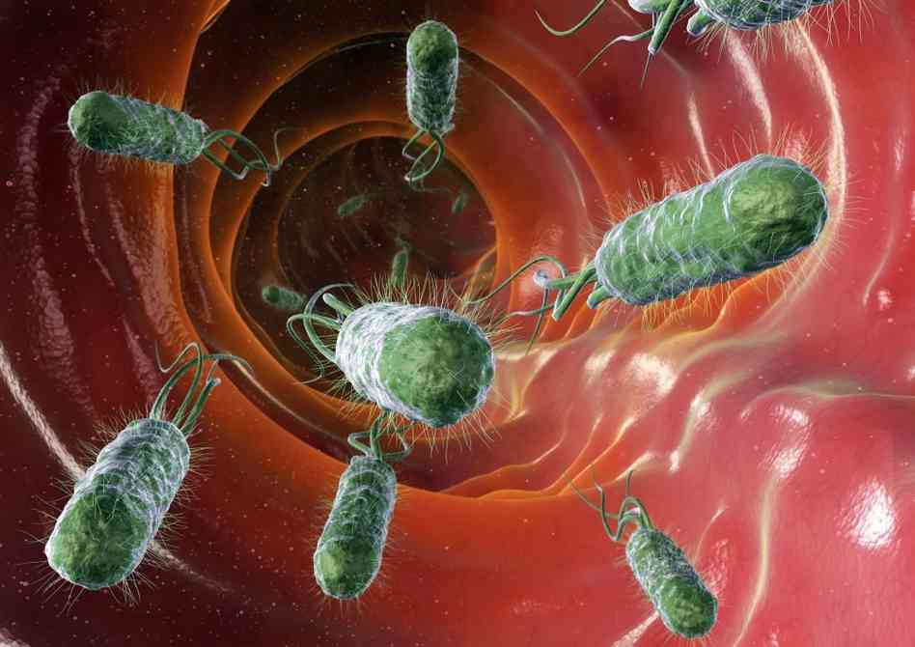
Decomposers
Help the ecosystem recycle nutrients
When a tree dies and falls to the forest floor, armies of bacteria attack and digest the dead tissue
The bacteria break the dead matter into simpler substances, which are released into the soil and taken up by the plants (picture: food in human digestive tract)

Slide 40
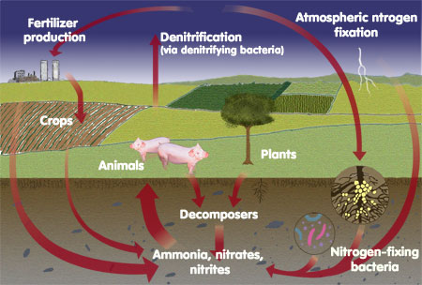
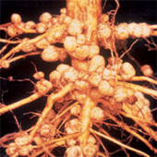
Nitrogen Fixers
Plants and animals depend on bacteria for nitrogen (amino acids → proteins)
80% of the atmosphere is nitrogen gas
Plants need nitrogen in the form of ammonia
Certain bacteria are able to convert nitrogen
Nitrogen Fixation: process of converting nitrogen gas into ammonia

Slide 41
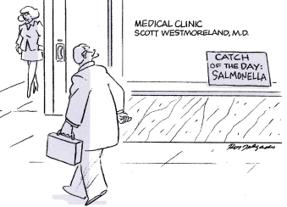
Bacteria and Disease
Cause disease by destroying living cells or by releasing chemicals that upset homeostasis
Damaging host tissue
Releasing toxins

Slide 42
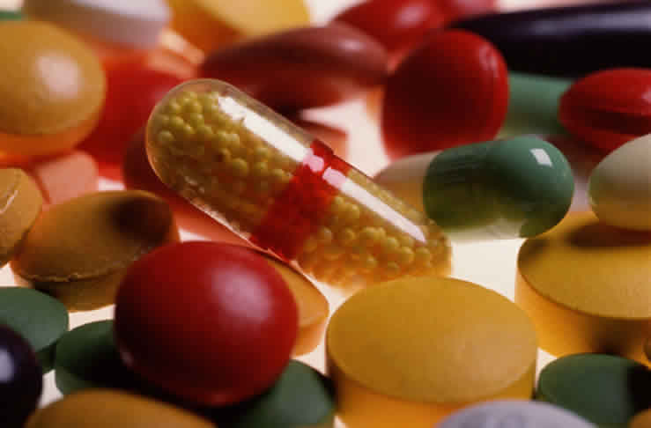
Antibiotics
Compounds that block the growth and production of bacteria
Can be used to cure many bacterial diseases

Slide 43
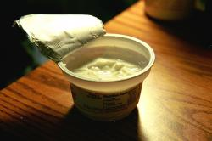
Human Uses of Bacteria: Foods
Cheese
Yogurt
Buttermilk
Sour cream
Pickles
Sauerkraut
Vinegar from wine

Slide 44
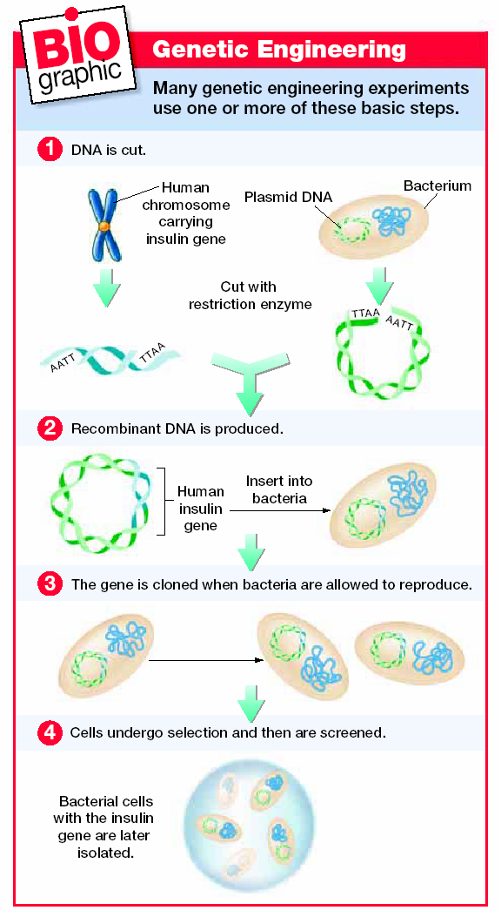
Human Uses of Bacteria: Industry
Digest petroleum (helpful in cleaning up oil spills)
Remove waste products and poisons from water
Mine minerals from the ground
Synthesize drugs and chemicals through genetic engineering

Slide 45
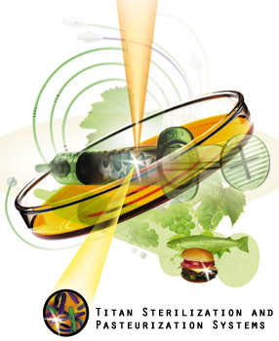
Controlling Bacteria
Physical removal
Soap and running water that dislodge bacteria and viruses
Disinfectants
Chemical solutions that kill bacteria
Food storage
Low temperatures slow bacteria growth
Food processing
Boiling, frying, or steaming can kill bacteria
Sterilization by Heat
Use of heat on objects such as medical instruments can prevent the growth of potentially dangerous bacteria

